Slide 1
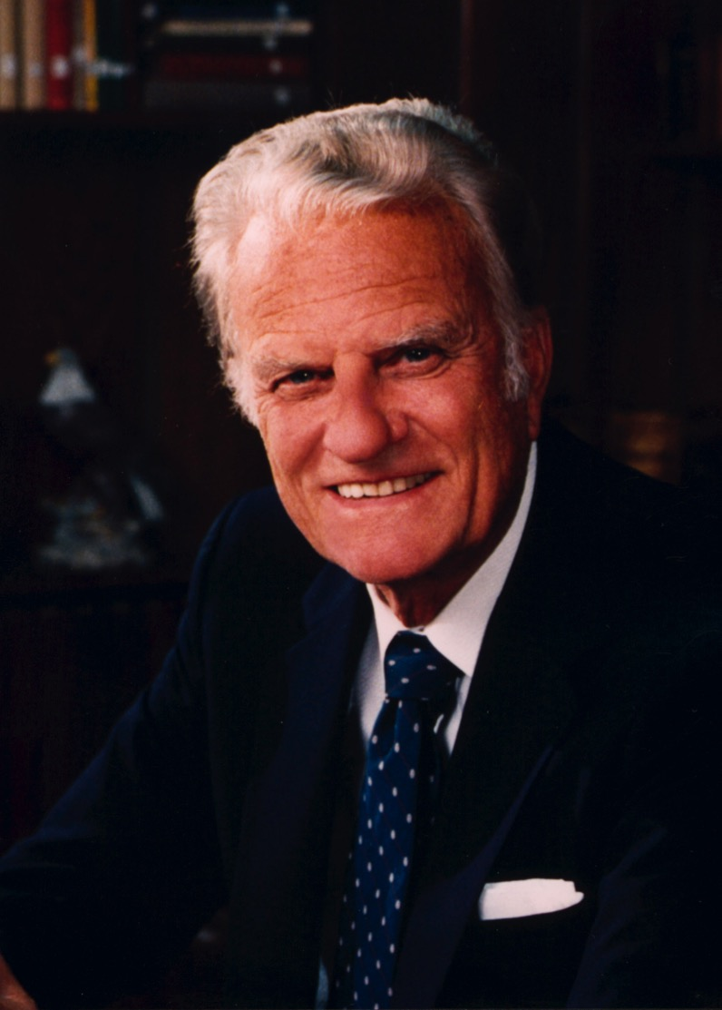
Introductions
Conclusions
Billy Graham began and ended his ministry well
How can you begin and end your sermon well?
Dr. Rick Griffith • Jordan Evangelical Theological Seminary • BibleStudyDownloads.org

Slide 2
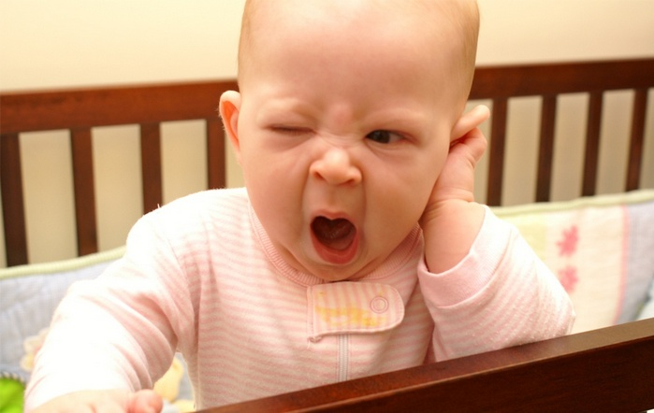
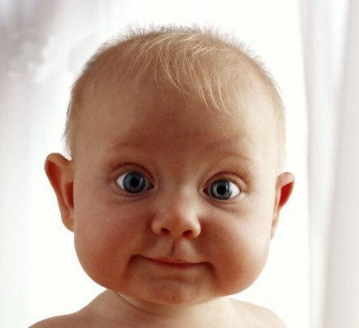
Introducing Your Sermon
Notes:
One of the key purposes of the introduction is to bring the audience from here…
To here!

Slide 3
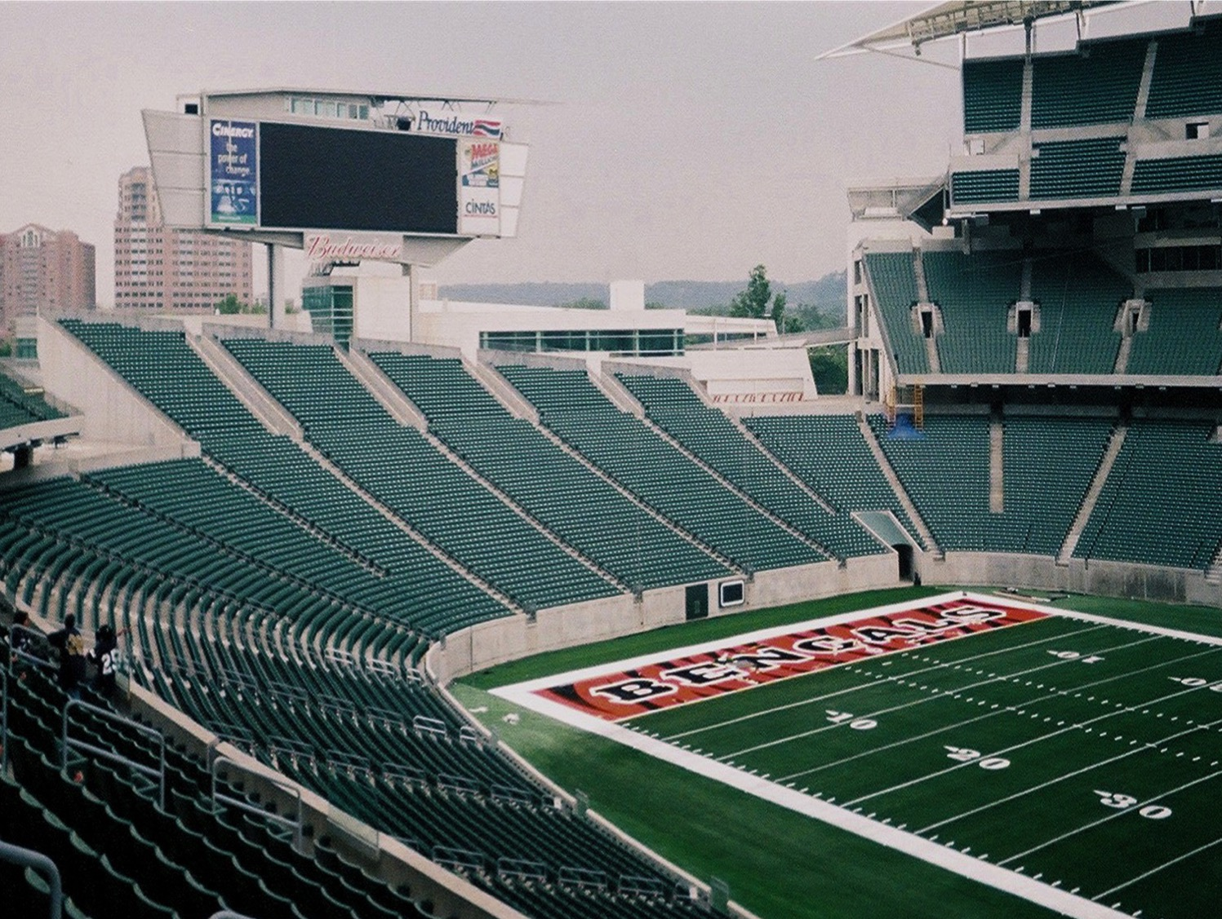
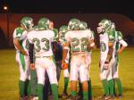
The Two Minute Warning
74
"For the preacher, the two minute warning comes at the beginning of the game."
Haddon Robinson, Biblical Preaching, 167
Notes:
In American football, the clock in the around 3-hour game always stops at 00:02 minutes before it hits 00:00 and ends the game. This is called the "Two Minute Warning." At this point both teams huddle and decide what they will do for the final two minutes to try to win the game.
However, in preaching, there is also a "Two Minute Warning." This is the FIRST two minutes of preaching when listeners decide in the first two minutes whether even to “play the game” or not! Unlike American footnball, listeners decide this the FIRST two minutes rather than the LAST two minutes!

Slide 4
There are three types of preachers:
74
Those to whom you cannot listen
Those to whom you can listen
Those to whom you must listen
During the introduction the congregation usually decides the kind of speaker addressing them that morning.
Haddon Robinson, Biblical Preaching, 167

Slide 5
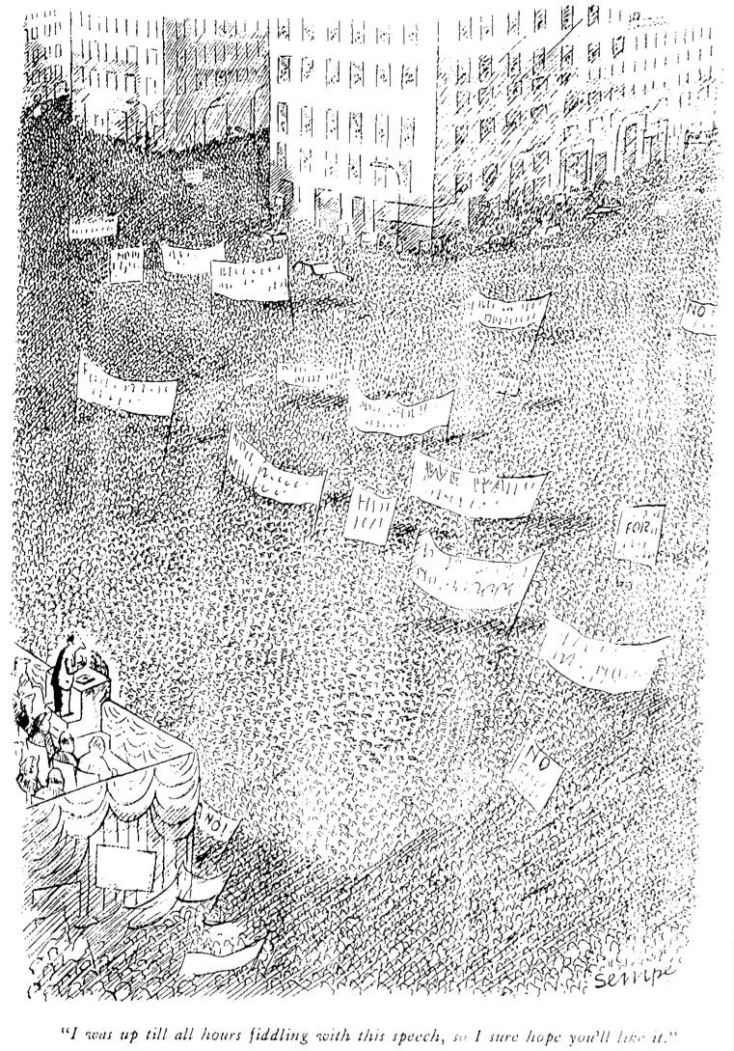
Don't Apologize!
What examples of sermons that began with apologies can you give?
"I got a late start on this sermon, so it's not going to be very good…"
"Sorry but I can't speak English…"
"The dog ate my first sermon manuscript, so I've had to do it over…"
"I was up till all hours fiddling with this speech, so I sure hope you'll like it."

Slide 6
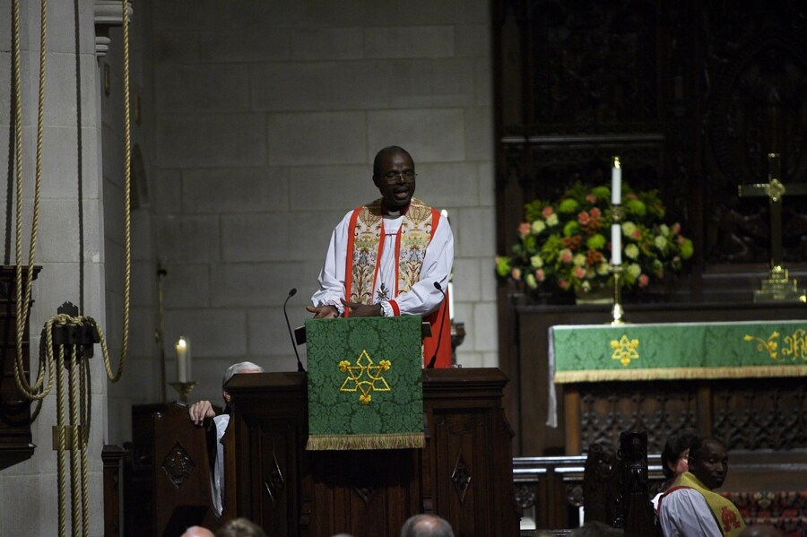
Introductions
74
GRIP PAT
STAIN
G R I P P A T
S T A I N
Conclusions
Acronyms can help recall what to include

Slide 7
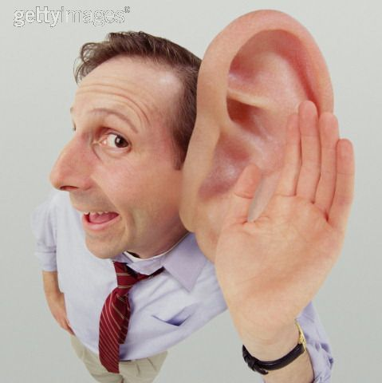
Introductions
74
GRIP PAT
Get Attention on the Subject

Slide 8
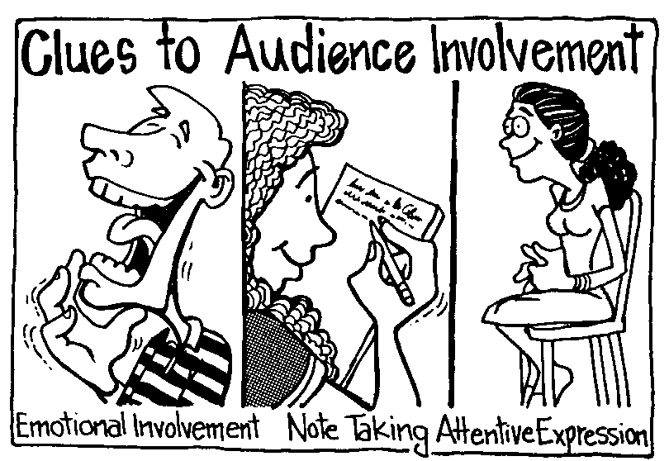
Clues to Audience Involvement
Emotional Involvement
Note Taking
Attentive Expression
Ken Davis, Secrets to Dynamic Communication

Slide 9
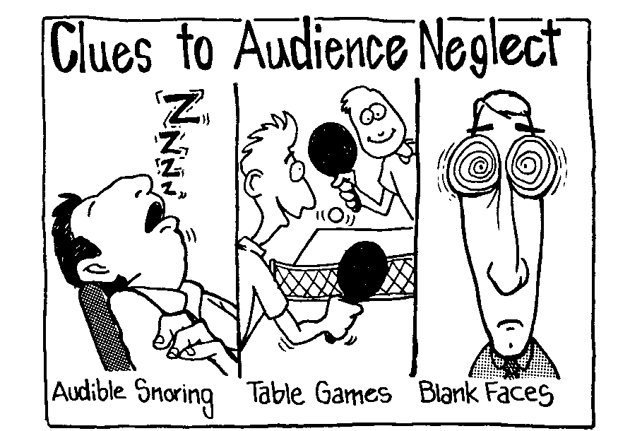
Clues to Audience Neglect
Audible Snoring
Table Games
Blank Faces
Ken Davis, Secrets to Dynamic Communication

Slide 10
Get their attention early or else!
"They say it's a tough church to preach at."
Notes:
In the USA "The Gong Show" was an old show where the judges could immediately stop the singer or poet or other performer simply by hitting the gong. The performer then had to leave the stage at the point without finishing his act!

Slide 11
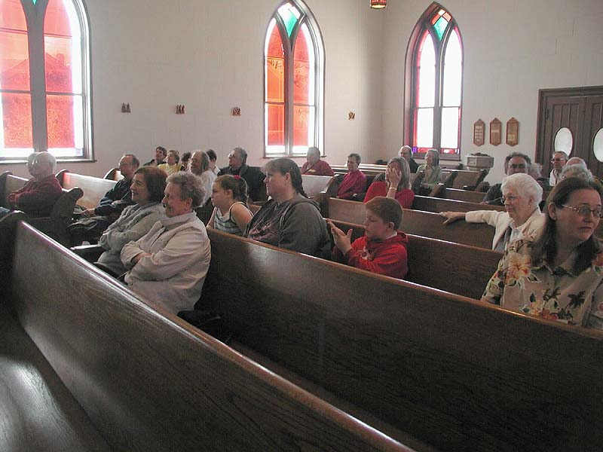
The Remote Syndrome
Audiences have "remotes" in their heads and can switch channels at any moment when they sense something else is more interesting! Work to keep their interest!
Notes:
The old woman on the left has kept her remote to what the pastor is saying as she smiles and enjoys his message.
But the boy in the middle finds his hands more interesting! His remote is in "body" mode.
The lady on the right finds talking to her neighbor more interesting, so her remote is also on a different channel.

Slide 12
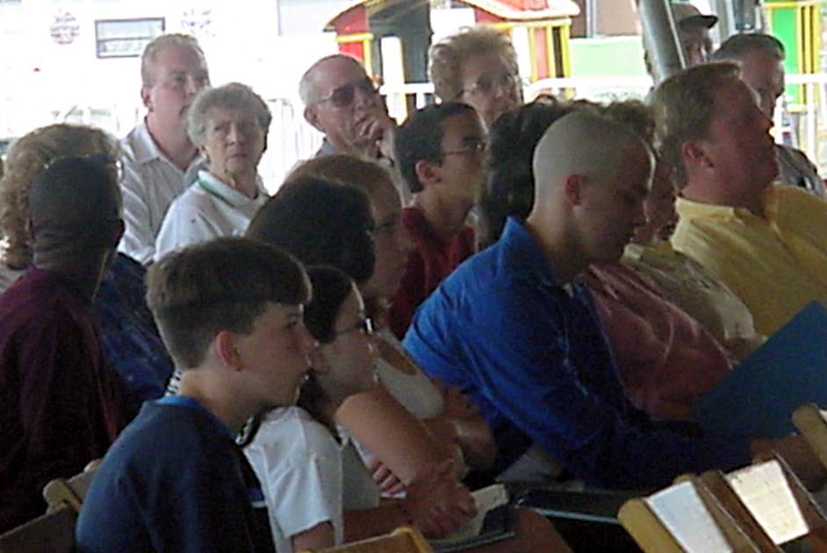
What do you think of these openers?
76
What are they really thinking?
Lewis B. Smedes describes it well…
In Hostetler, Introducing the Sermon, 27

Slide 13
"Wasn't everybody expecting a resurrection?"
76
Do you think this is a good first sentence for a sermon?
Why or why not?
Notes:
This doesn't seem to be a good opener as people aren't thinking about the resurrection of Christ as the preacher begins speaking.

Slide 14
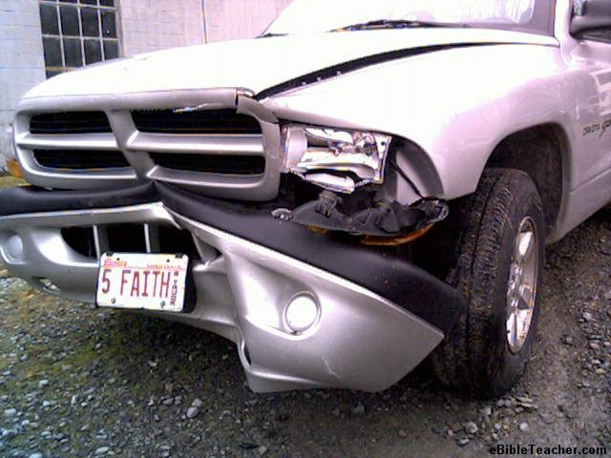
"If you wanted to destroy a society without the use of weapons, how would you do it?"
76
Is this one a good opener? Why or why not?
Notes:
This is the beginning of a sermon on the importance of the family.
I think this is a good first line of a sermon.

Slide 15
"At first, this proposition may seem contradictory."
76
(Referring to the sermon title, "What the World Needs is Fewer Churches and More Bodies of Christ.")
Good beginning or not?
Notes:
This doesn't seem to be a good opener as people aren't reading the sermon title of the same name. The preacher is assuming too much!

Slide 16
How can you get attention?
See Sunukjian's list on page 76a

Slide 17
Introductions
74
GRIP PAT
Get Attention on the Subject
Raise Need or Arouse Curiosity
Help them admit that they wear masks
How can you raise need?
Ask "you" questions!
Notes:
We all come to church with masks over how we really feel and how we are really doing.

Slide 18
You have very little time to raise need
Thirty Minutes to Raise the Dead: How You Can Preach Your Best Sermon Yet – This Sunday

Slide 19
Introductions
74
GRIP PAT
Get Attention on the Subject
Raise Need
Introduce the Subject, MI, or MPI
Provide Background

Slide 20
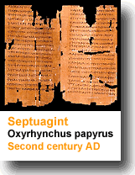
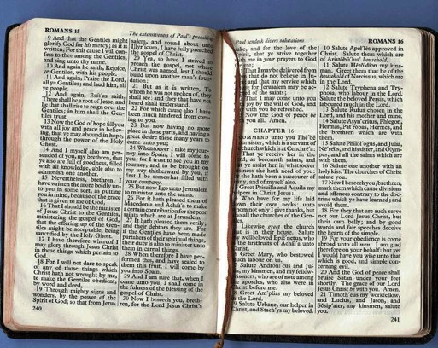
Share only relevant background
Give background before text
Need
Background
Text

Slide 21
Introductions
74
Contact Points
GRIP PAT
Secular
Get Attention on the Subject
Raise Need
Introduce the Subject, MI, or MPI
Provide Background
Personal
Structural
Biblical
Contact points from Hostetler, Introducing the Sermon

Slide 22
Introductions
74
GRIP PAT
Get Attention on the Subject
Raise Need
Introduce the Subject, MI, or MPI
Provide Background
Preview Outline

Slide 23
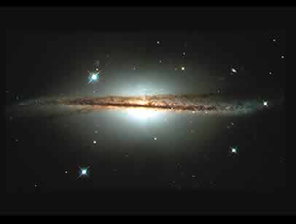
Previewing Your Message
What it does
Reviews your subject
Gives the number of MPs (but not the whole points themselves)
Examples
Today's passage will show us…
2 ways to reverence God (pp. 51, 82)
3 reasons we should get dirty for others (p. 148)
3 principles on finding a mate (p. 157e)
what God thinks of missions and what we should do in response (p. 156)
Notes:
17.23

Slide 24
Introductions
74
GRIP PAT
Get Attention on the Subject
Raise Need
Introduce the Subject, MI, or MPI
Provide Background
Preview Outline
Announce Text (2-3 times)
Transition to MPI
Notes:
17.24; 17.36

Slide 25
Types of Transitions
68
Subject: How can we know how to speak to non-Christians (Col. 4:6c)?
Preview: We will see two ways to speak to non-Christians.
Incomplete Sentence
(The first way to speak to non-Christians is to…)
I. Speak gracious words (6a)
(The second way to speak to non-Christians is to…)
II. Speak wise words (6b)
Notes:
______________
PR-15-Clarity-22
PR-17-Intro & Concl-25

Slide 26
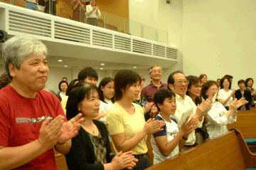
The Conclusion
75

Slide 27
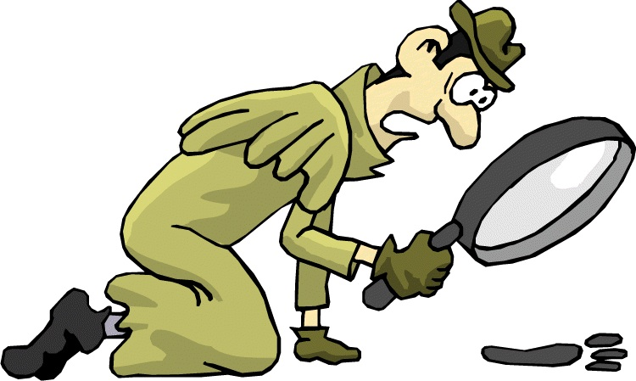
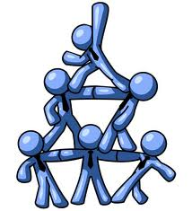
Why are good conclusions so vital?

Slide 28
Conclusions are Remembered
75
What people remember most are the speaker's first words and last words.
If you are going to make a mistake, let it occur in the middle!

Slide 29
Introductions
GRIP PAT
STAIN
G R I P P A T
S T A I N
Conclusions
Notes:
Do you remember the acronym for elements of introductions?
Yes, GRIP PAT
What is the acronym for five elements of conclusions?
STAIN

Slide 30
Conclusion Elements
STAIN
State your MI (or restate it)
Tell the Main Points
Conclusions

Slide 31
An Old Adage on Clarity
75
Tell
Them
Tell them what you are going to tell them
Then tell them what you told them

Slide 32
Conclusion Elements
STAIN
State your MI (or restate it)
Tell the Main Points
Apply or exhort obedience
Include variety
Conclusions

Slide 33
Include Variety
Finally, my brothers...
I sense another speech coming on.
Don't always end with a poem or prayer

Slide 34
Conclusion Elements
STAIN
State your MI (or restate it)
Tell the Main Points
Apply or exhort obedience
Include variety
Never announce a conclusion
Conclusions

Slide 35
Don't Announce It
And in conclusion...
All right!
Yeah!
Amen!
DON'T ANNOUNCE YOUR CONCLUSION
Close it down, brother!
Notes:
Paul did this in Philippians 3:1 when he declared, "Finally, my brothers…" and then went another two chapters!

Slide 36
Introductions
74
GRIP PAT
Get Attention on the Subject
Raise Need
Introduce the Subject, MI, or MPI
Provide Background
Preview Outline
Announce Text (2-3 times)
Transition to MPI
Notes:
17.24; 17.36

Slide 37
Conclusions Review
74
STAIN
S
T
A
I
N
State your MI (or restate it)
Tell the Main Points
Apply or exhort obedience
Include Variety
Never announce a conclusion
Conclusions

Slide 38
Black

Slide 39
Preaching (Homiletics) link at BibleStudyDownloads.org
Get this presentation for free!
Notes:
Preaching (pr)
Homiletics

